Slide 1

Myntra Product Analysis
Puram Teja
Batch No :436
Innomatics Research
Labs Dilshuknagar

Slide 2
About me
I am Puram Teja.
I completed my B.Tech in Computer Science and Engineering (Data Science) from Kommuri Pratap Reddy Institute of Technology, Hyderabad.
LinkedIn : https://www.linkedin.com/in/puramteja
GitHub :https://github.com/puramteja131

Slide 3
AGENDA :
Business Problem
Business Objective
Data Collection & Data Understanding
Dataset Overview
Tools & Technologies
Data Cleaning & Preprocessing
Exploratory Data Analysis (EDA)
Hypothesis Testing
Challenges Faced
Key Insights
Conclusion

Slide 4
Business Problem Statement :
Myntra has a large number of products across different categories, making it difficult to compare products.
Customers may find it difficult to choose products based on price, rating, and reviews.
Prices and ratings vary across different product categories.
There is a need to understand which brands have more products.
Data analysis can help identify useful patterns in product prices, ratings, and reviews.

Slide 5
Business Objective :
Collect Myntra product data using web scraping.
Clean and prepare the collected data for analysis.
Perform basic data analysis and exploratory data analysis (EDA) using statistics and visualizations.
Identify trends and differences in prices, ratings, reviews, brands, and categories.
Use statistical tests to check relationships and differences in the data.
Present the findings through clear visualizations and insights.

Slide 6
Dataset Overview:
Total number of products: 550
Total number of columns: 7
The dataset contains product information from Myntra.
Columns in the dataset: Rating, Reviews, Brand, Product Name, Price, Size, Category
The dataset was used to analyze product prices, ratings, reviews, brands, and categories.

Slide 7
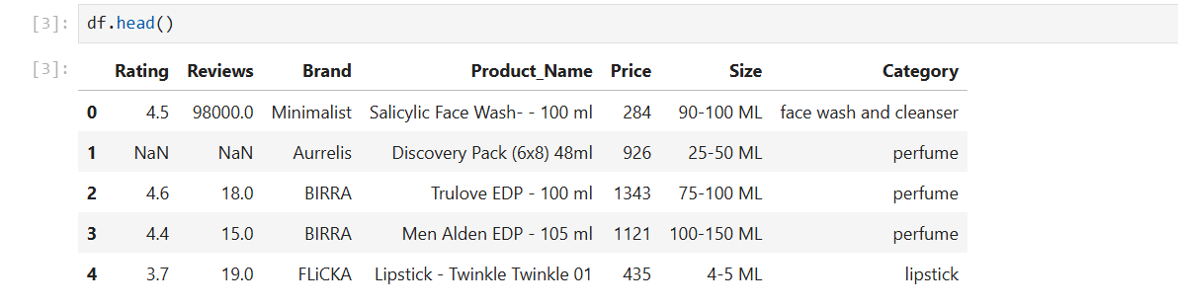
Dataset Preview:

Slide 8
Tools & Technologies:
Python
Selenium
Pandas
Matplotlib
Seaborn
SciPy
Jupyter Notebook

Slide 9
Data Cleaning & Preprocessing :
Checked missing values in the dataset.
Rating and Reviews had missing values.
Kept missing Rating and Reviews because some products had no ratings or reviews.
Converted Rating, Reviews, and Price to appropriate data types.
Removed extra spaces from text columns.

Slide 10
Exploratory Data Analysis (EDA)
Univariate Analysis
Bivariate Analysis
Multivariate Analysis
Statistical Hypothesis Testing

Slide 11
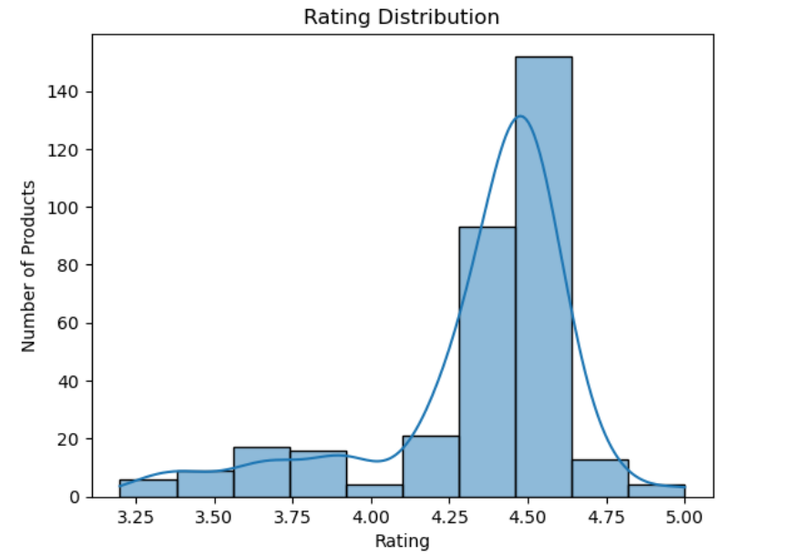
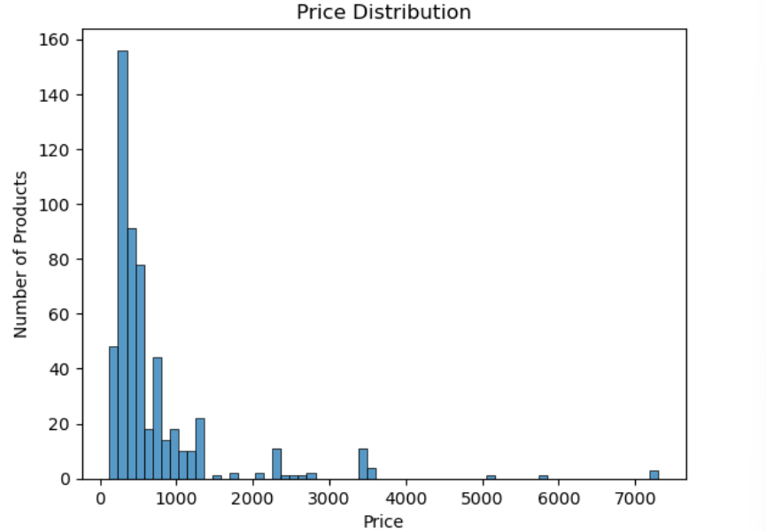
Univariate Analysis:
Most products are priced below ₹1,000.
The price distribution is right-skewed, meaning most products have lower prices.
A few products have very high prices above ₹5,000, which can be considered high-price outliers.
Most products have ratings between 4.25 and 4.60.
A rating around 4.5 is the most common.
Overall, the products have relatively high ratings.

Slide 12
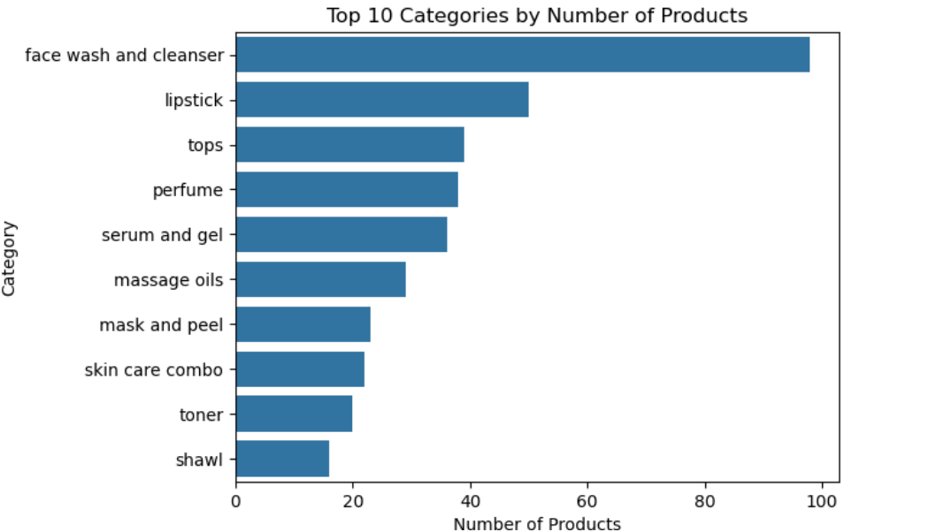
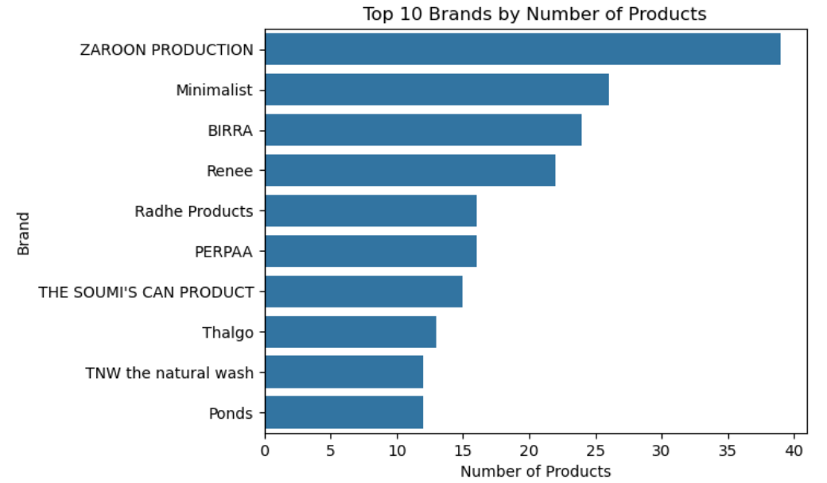
Face wash and cleanser has the highest number of products (98).
Lipstick is the second highest with 50 products.
Tops and perfume also have a high number of products, while shawl has the lowest count among the top 10.
ZAROON PRODUCTION has the highest number of products with 39.
Minimalist has 26 products, followed by BIRRA with 24.
The other brands have fewer products compared with the top brands.

Slide 13
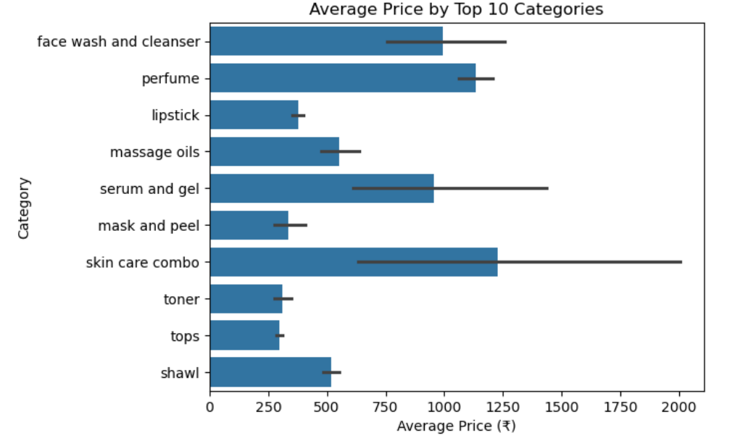
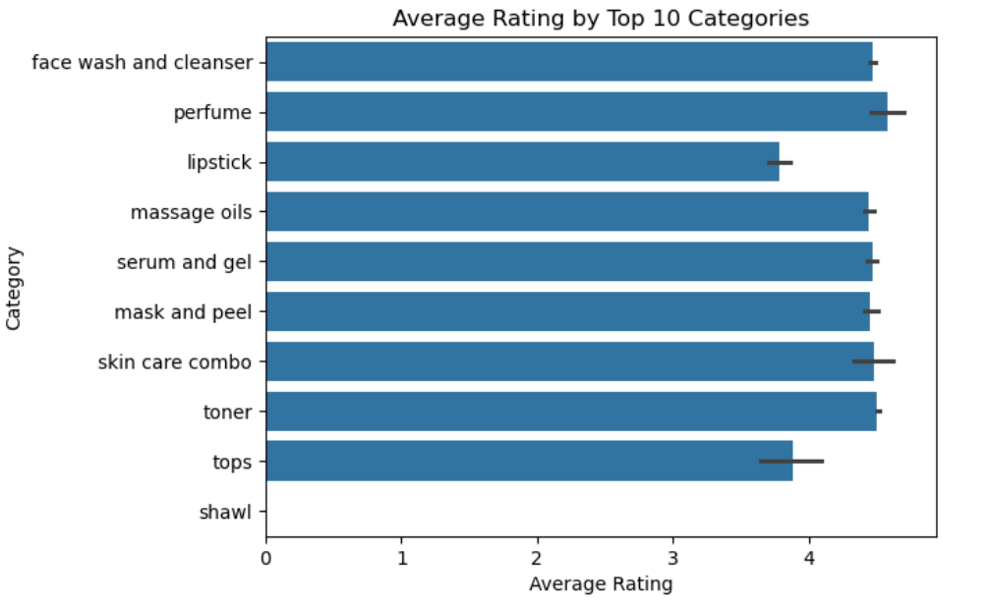
Bivariate Analysis:
Skin care combo has the highest average price among the top 10 categories.
Lipstick, tops, toner has the lowest average price.
Perfume and face wash also have relatively high average prices.
Perfume has the highest average rating among the top 10 categories.
Most categories have average ratings above 4.0, showing generally high ratings.
Lipstick and tops have relatively lower average ratings compared with the other categories.

Slide 14
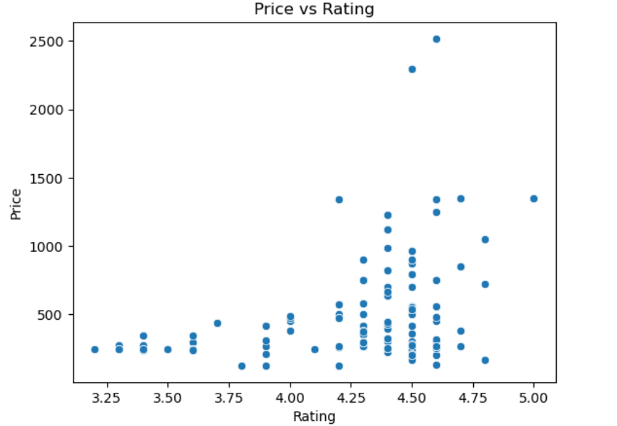
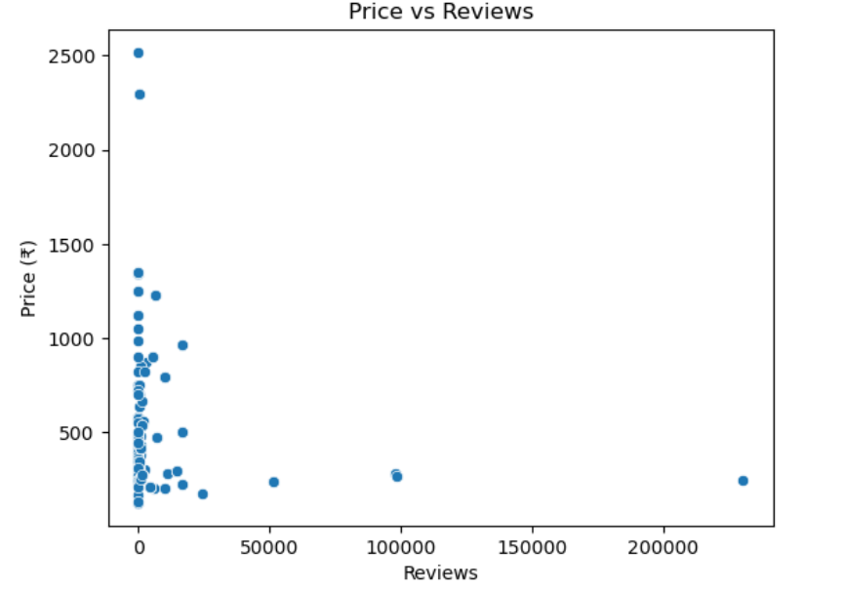
Most products have a small number of reviews.
A few products have very high review counts, appearing as outliers.
There is no clear relationship between Price and Reviews.
There is no clear relationship between Price and Rating.
Products with similar ratings have different prices.
Higher ratings do not always mean higher prices.

Slide 15
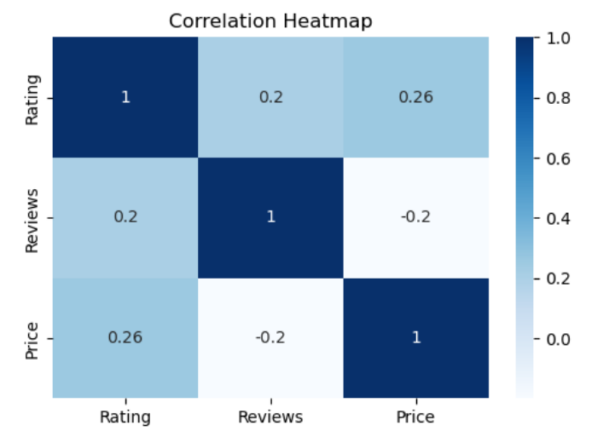
Multivariate Analysis:
Rating and Price have a weak positive correlation (0.26)
Rating and Reviews have a weak positive correlation (0.20).
Reviews and Price have a weak negative correlation (-0.20).
Overall, there is no strong relationship among Rating, Reviews, and Price.

Slide 16
Evaluation (Hypothesis Testing):
Category vs Price
Null Hypothesis (H₀):
There is no significant difference in average price across different categories.
Alternative Hypothesis (H₁):
There is a significant difference in average price across different categories.
• A one-way ANOVA test was performed to compare the average prices across different categories.
• The test result showed a statistically significant difference in average prices across categories.
• Since the p-value was less than the significance level (α = 0.05), the null hypothesis (H₀) was rejected, indicating a statistically significant difference in average price across categories.

Slide 17
Evaluation (Hypothesis Testing):
Category vs Rating
Null Hypothesis (H₀):
There is no significant difference in average rating across different categories.
Alternative Hypothesis (H₁):
There is a significant difference in average rating across different categories.
• A one-way ANOVA test was performed to compare the average ratings across different categories.
• The test result showed a statistically significant difference in average ratings across categories.
• Since the p-value was less than the significance level (α = 0.05), the null hypothesis (H₀) was rejected, indicating a statistically significant difference in average rating across categories.

Slide 18
Evaluation (Hypothesis Testing):
Price vs Rating
Null Hypothesis (H₀):
There is no significant linear relationship between Price and Rating.
Alternative Hypothesis (H₁):
There is a significant linear relationship between Price and Rating.
A Pearson correlation test was performed to examine the relationship between Price and Rating.
The test result showed a statistically significant positive relationship between Price and Rating.
Since the p-value was less than the significance level (α = 0.05), the null hypothesis (H₀) was rejected.
The correlation value (r = 0.257) indicates that the relationship is weakly positive.

Slide 19
Challenges:
Dynamic content loading made web scraping more challenging.
Missing values were present in Rating and Reviews.
Price and Reviews had high-value outliers, making the distributions highly skewed.

Slide 20
Key Insights:
Face wash and cleanser is the most common category, with 98 products.
ZAROON PRODUCTION appears most frequently in the dataset, with 39 products.
Most products have high ratings, mainly between 4.3 and 4.6.
Most products are priced below ₹1,000, while a few products have very high prices.
Price, Rating, and Reviews have no strong relationship.

Slide 21
Conclusion:
This project showed an end-to-end data analysis workflow using Myntra product data.
Product data was collected through web scraping, cleaned, and prepared for analysis.
Exploratory data analysis and visualizations helped us find common trends in product categories, brands, prices, ratings, and reviews.
Hypothesis testing was used to statistically analyze differences and relationships in the data.
Overall, the analysis provided useful insights into product pricing, ratings, reviews, and category distribution.

Slide 22


Slide 23

THANK YOU

